Slide 1


3D Virtual Reality Space Station Builder & Simulator

Slide 2
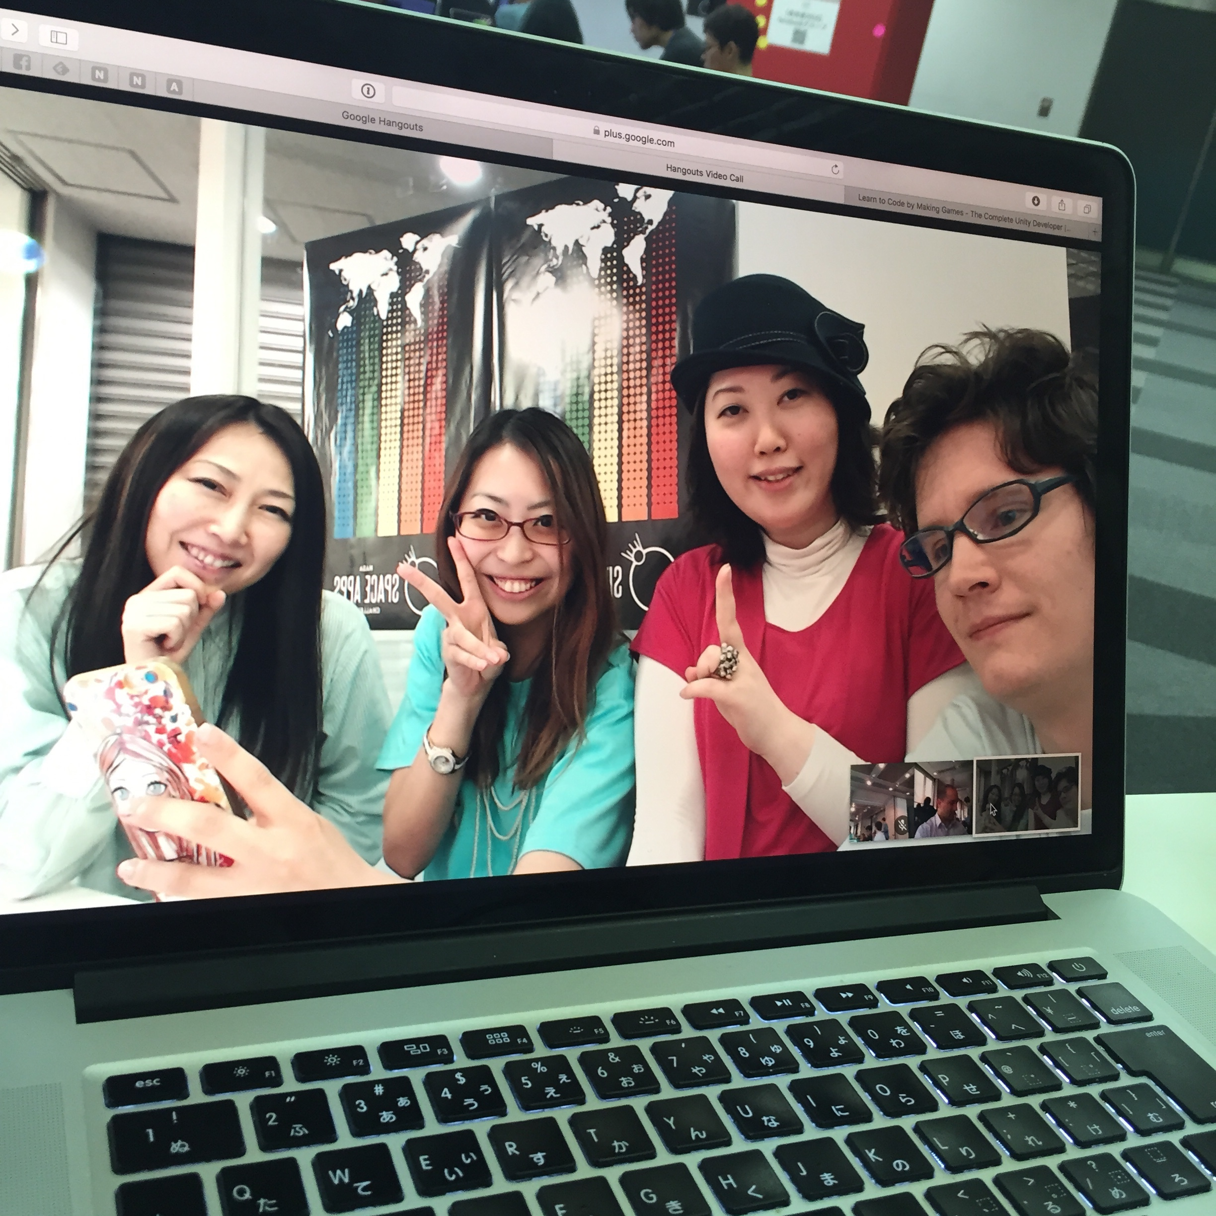
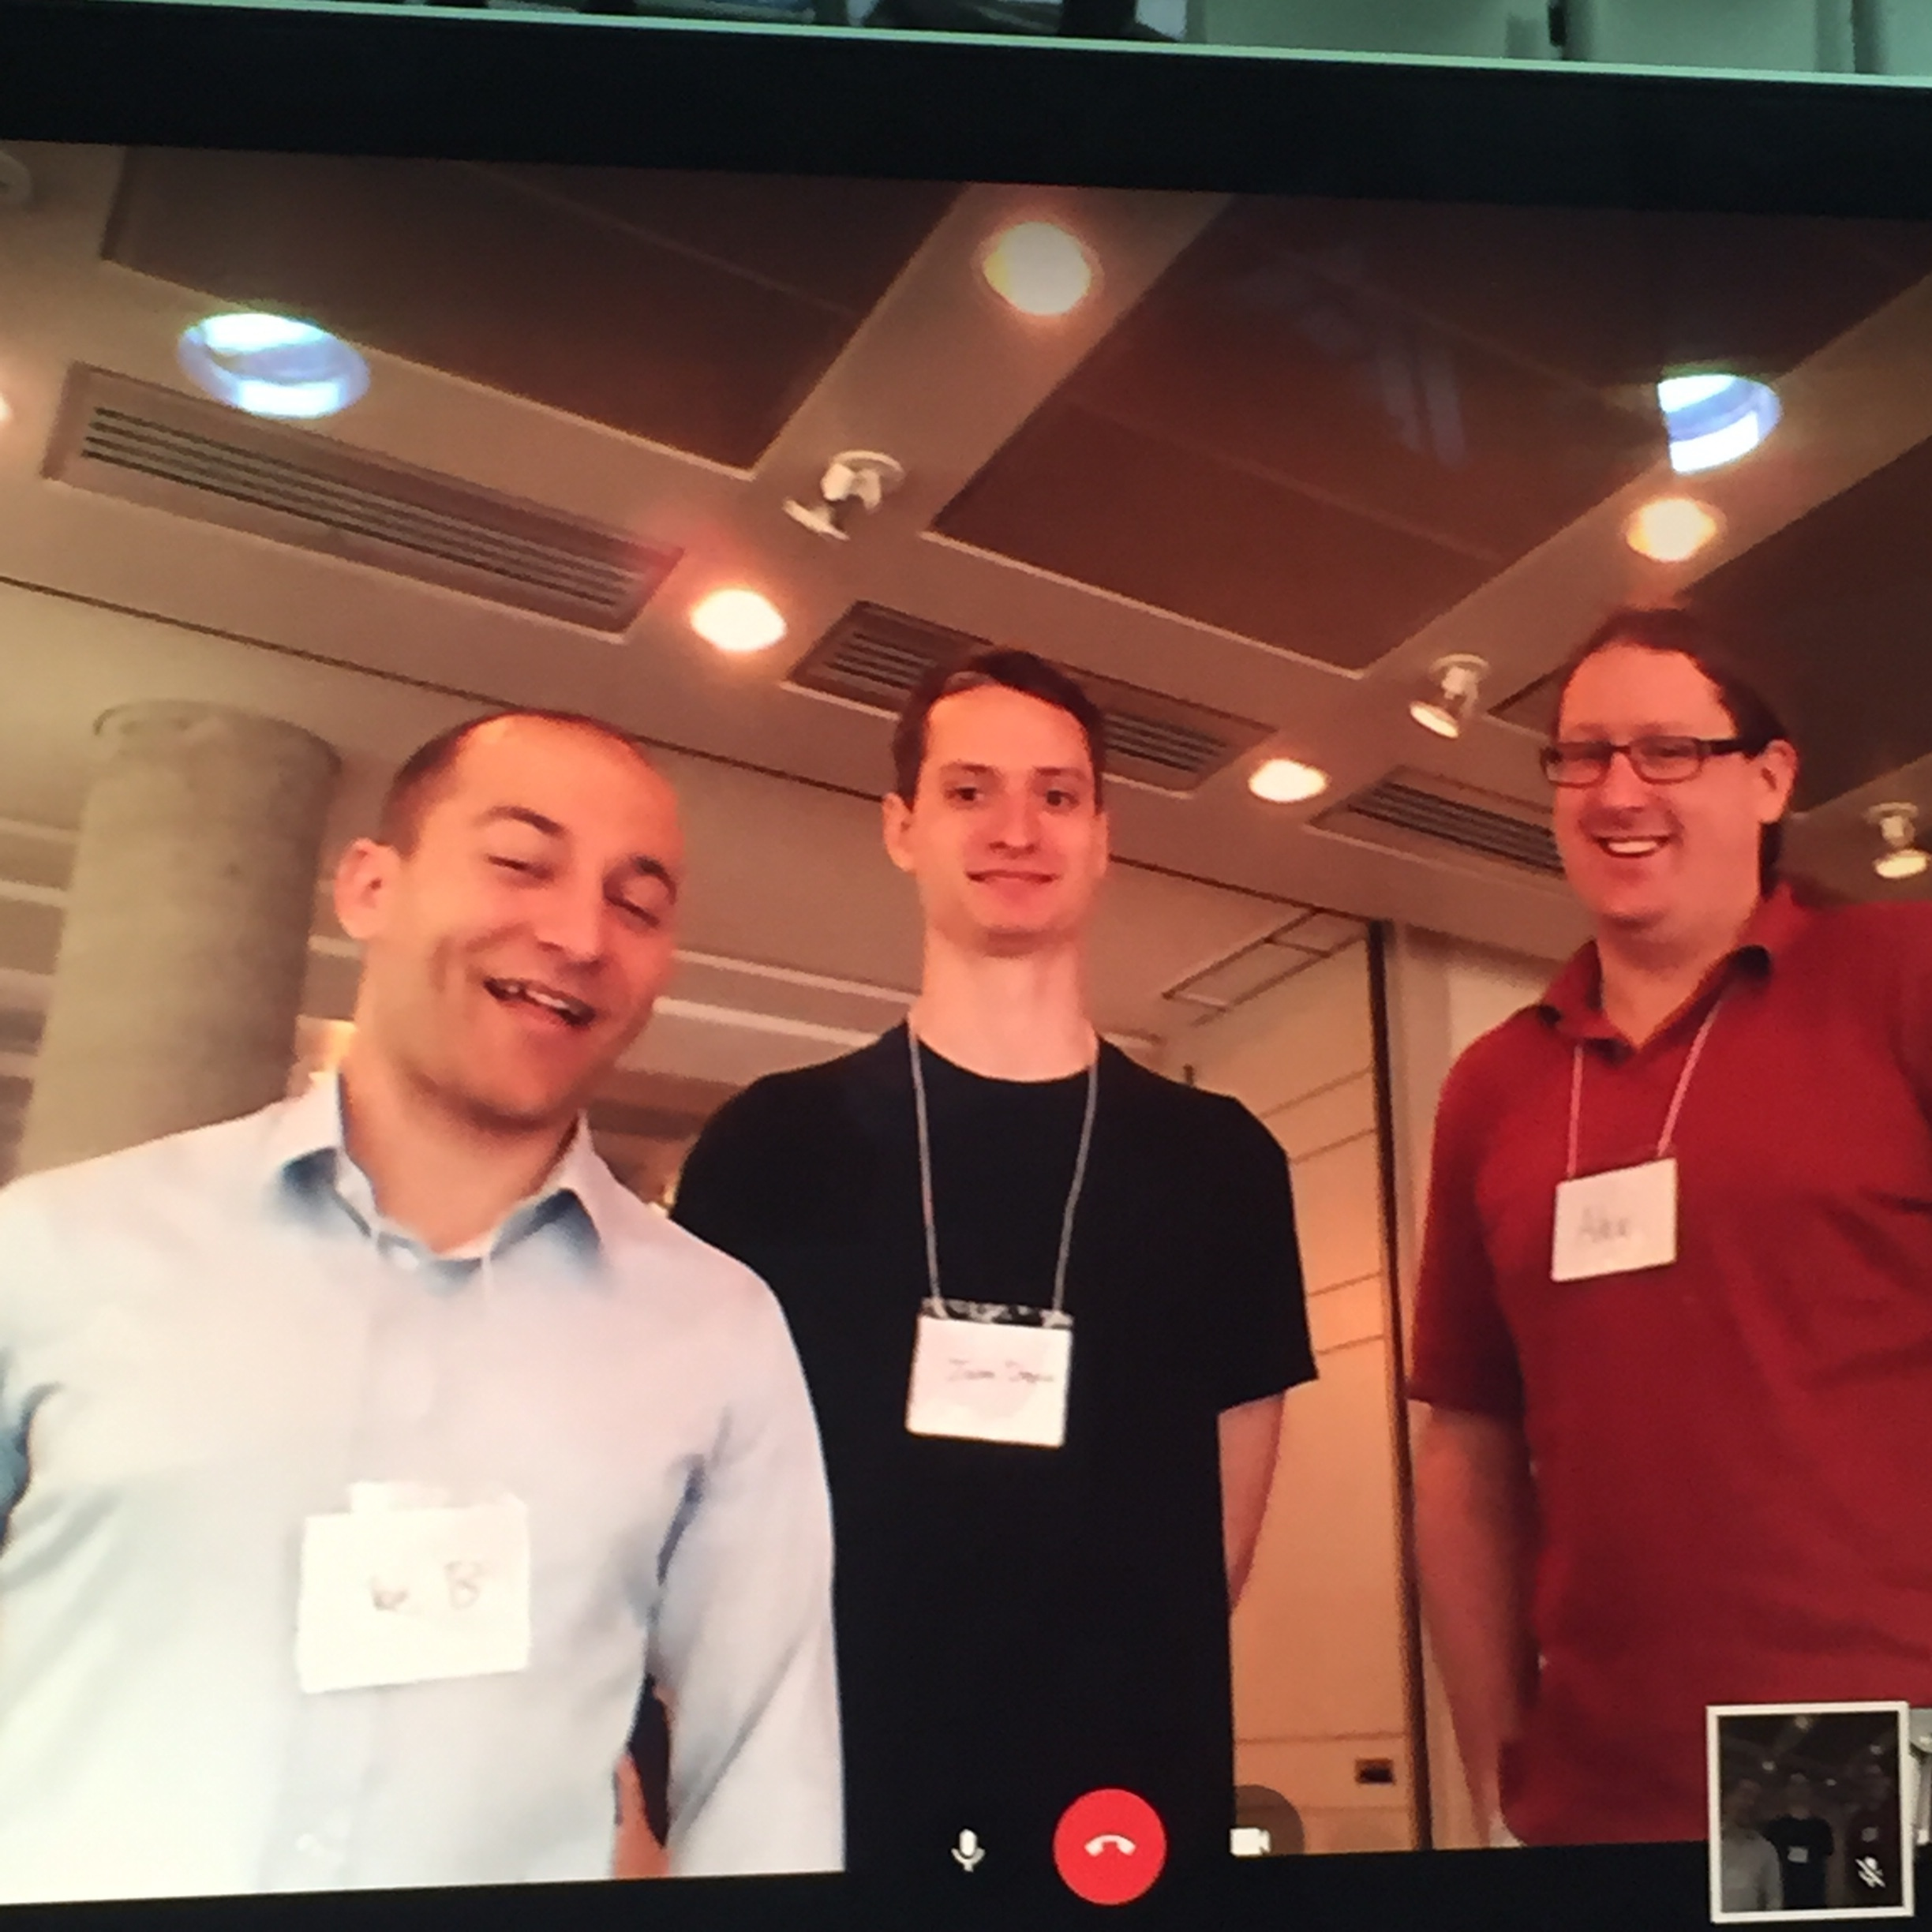
Our Team

Slide 3
Basic Functions
Build a Space Station!
View from the inside in 3D
Create new modules with various functions
Travel to each module – they all exist in space together

Slide 4
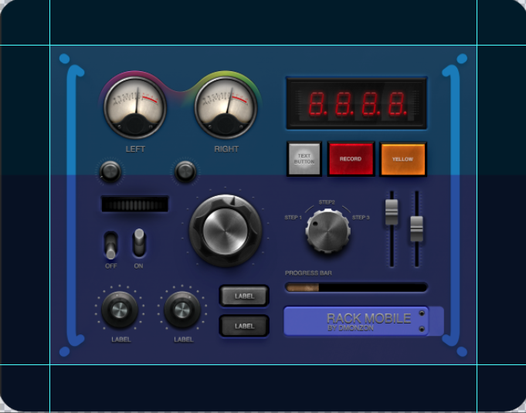
The Interface

Slide 5
Build your own!

